Slide 2
Oracle SQL Developer Data Modeler 3.0: Technical Overview
March 2011

Slide 3
Contents
Data Modeling
Why model?
SQL Developer Data Modeler Overview
Technology and architecture
Features
Logical, relational, and physical modeling
Data types and multi-dimensional modeling
Forward and reverse engineering
Importing and exporting
Integrated and repository based reporting
Integrated version control for collaborative development
Custom Design Rules and transformations
Finding out more…

Slide 4
Why Do You Need to Model Today?
A diagram is a powerful communication tool
Different models provide different solutions
Logical Model (Conceptual model) for architects and users
Relational Model (Schema or Data Design) for developers
Physical model for database administrators
Viewer for all users
Data models improve application development
Maintenance is easier
Quality is improved
Good models drive standards

Slide 5
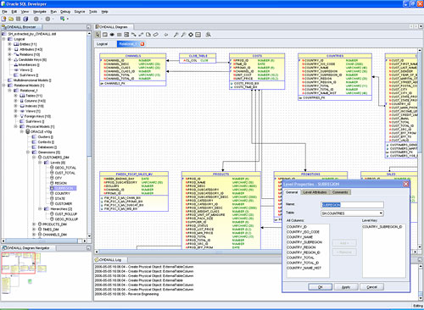
Oracle SQL Developer Data Modeler - Overview
A no cost diagramming and data modeling tool
A single tool for different users and functionality
Data Architect builds logical data models
Database Developer models relational models (tables and columns)
DBA adds tablespaces, partitions
Use data models to
Verify accuracy and completeness of data requirements and business rules with customers
Build standards-driven DDL scripts
Metadata is stored in XML files

Slide 6
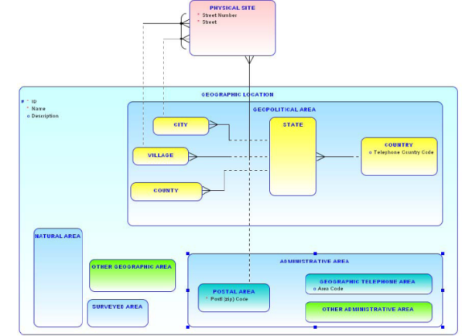
Oracle SQL Developer Data Modeler
Multi-level Data Modeling across platforms within one integrated system
Designing logical Entity Relation Diagrams (ERD)
Multi-dimensional modeling
User Defined Data Types
Building relational schema designs
Generating and executing DDL scripts
Reverse engineering of existing data structures
Import of data models from CA ERwin and Oracle Designer
Multi-level relational and physical design environment
Multiple platform support
Multiple database support
Increases migration productivity
Read only visualization of database data models
Notes:
More detailed list of features

Slide 7
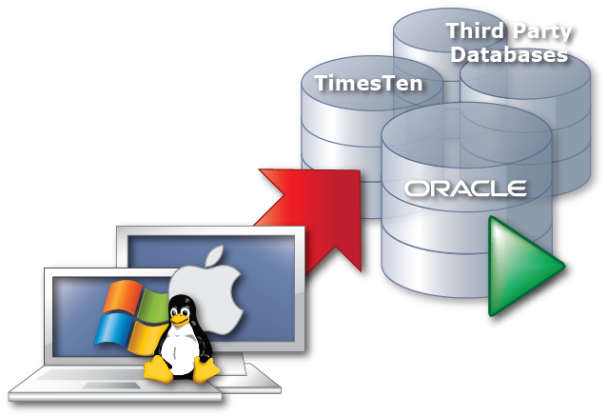
Technology and Architecture
Technology and Architecture
Java based
Implemented as independent, standalone product
Database support
Oracle 9i, 10g, and Oracle 11g
Third-party databases
Microsoft SQL Server
DB2, UDB
Platform support
Windows
Linux
Mac OSX

Slide 8
<Insert Picture Here>
Features

Slide 9
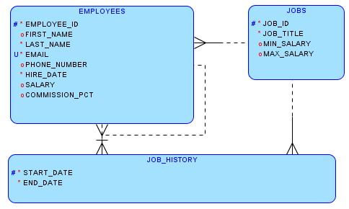
Logical Modeling
Model entities, attributes and relations
Support for
Super type
Sub types
Transform one logical to many relational and multi-dimensional models
Support for configurable forward and reverse engineering
Support for different modeling notations

Slide 10
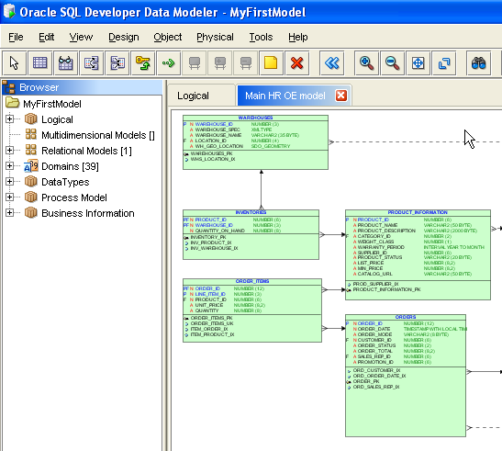
Relational Modeling
Model tables, columns and FKs
Create one logical for one or more relational models
Support configurable forward and reverse engineering
Use subviews to work with a subset of tables
Provide different displays of the same model

Slide 11
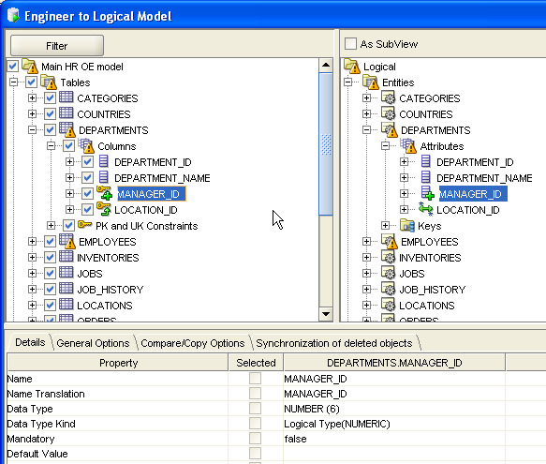
Forward and Reverse Engineering (Transformation)
Each logical model to maps to one or more relational models
Each relational model maps to one logical model
Each relational model maps to one or more physical models
Each physical model maps to one relational model
Engineering options
General
Compare/copy
Synchronization
Include design glossary and naming standards

Slide 12
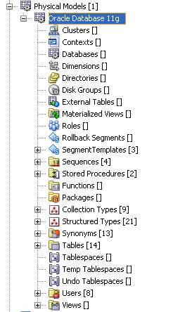
Physical Modeling
One relational model for many physical models
Add support for
Tablespaces
Users
Roles
Stored procedures
Propate properties
Apply properties to many elements at once
Supports
Oracle9i, Oracle Database 10g and Oracle Database 11g
Microsoft SQL Server 2000 and 2005
IBM DB2/390 and DB2 LUW

Slide 13
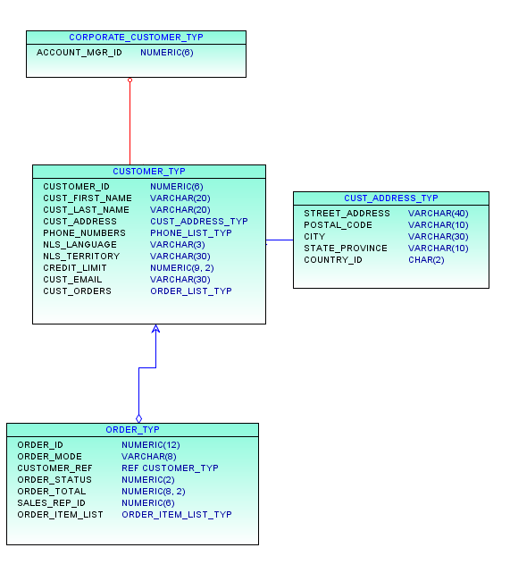
Modeling DataTypes
Support for SQL99 (Object Relational Modeling)
Distinct Types
(Predefined) Structured Types
(Predefined) Collection Types
Used in logical models
Used in relational models
Included on import
Generated in DDL

Slide 14
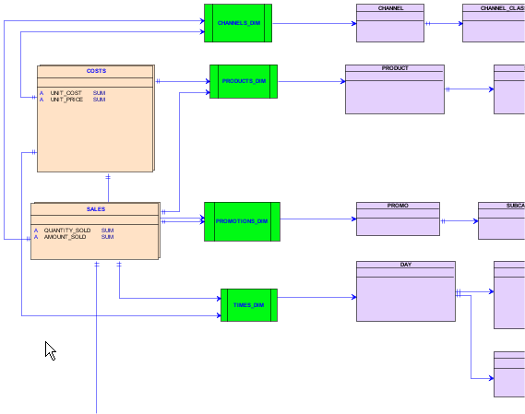
Multi-Dimensional Modeling
Modeling of Cubes, Dimensions, Levels and Hierarchies, Measures and slices
Start from ROLAP, XMLA or from scratch
Generate Oracle Analytical Workspaces

Slide 15
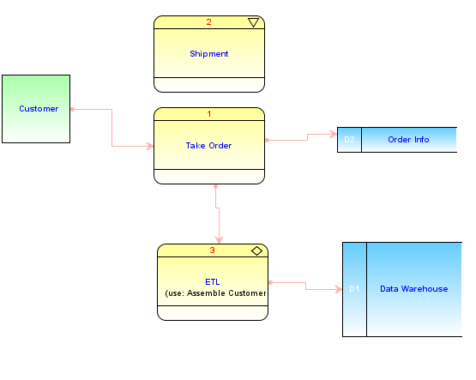
Working with Data Flow Diagrams
Data Flow
External Agents
Processes
Primitive
Composite
Transformation
Information Flow
Information Store

Slide 16
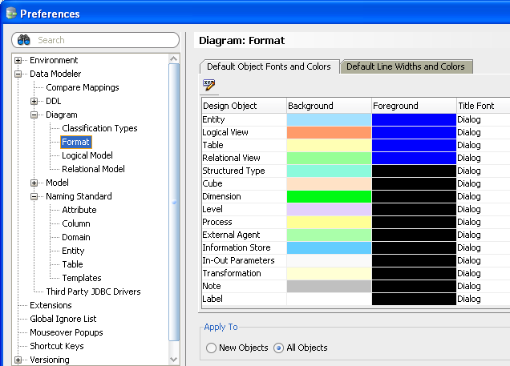
Formatting and General Appearance
Granular and general control
Set per item type
Synchronize tree with diagram
Set notation

Slide 17
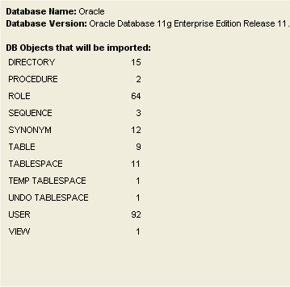
Importing Metadata
Import using direct connections
Oracle Database
Microsoft SQL Server
IBM DB2 and UDB
Generic JDBC based dictionary
Examples: MySQL, Teradata
Oracle Designer repository
File import
Other Modeling tools
CA ERwin
Bachman
Multi-Dimensional
Cube views
XMLA

Slide 18
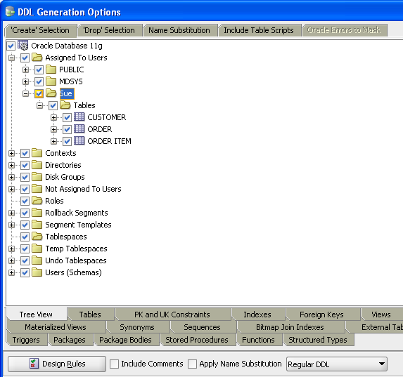
Exporting and Code Generation
DDL file editor supports
Design Rules
Object selection
Drop objects
Table scripts
Standard database DDL scripts
Oracle
IBM DB2 and UDB
Microsoft SQL Server
Multi-Dimensional Oracle AW, Cube Views and XMLA
CSV export

Slide 19
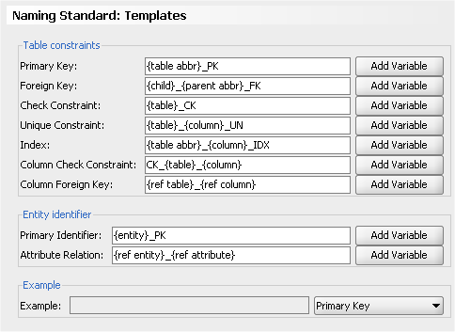
Controlling the Design Environment
Selection of tools available
Domain definition (data types)
Name abbreviation in the relational model (Customer to CUST)
Compare and merge facilities
Design Rules
Tools Options
Naming standards
Specify default database
Controlling constraints
Physical properties
Notations (Barker, Bachman, Information Engineering)

Slide 20
<Insert Picture Here>
New Features Review

Slide 21
SQL Developer Data Modeler 3.0
Integrated version control (Subversion) for collaborative development
Integrated reports
Incremental Oracle Database 11g features
Support for multiple open designs
Import and export packages, and functions
Addition of custom Design Rules and transformations
Import from CA ERwin Data Modeler Release 7
Various additional enhancement requests and feature updates

Slide 22
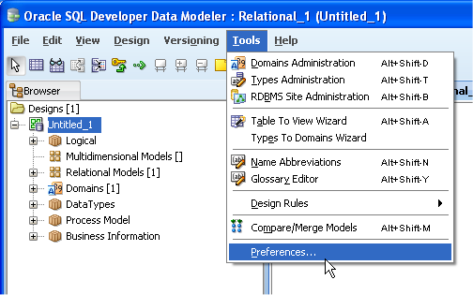
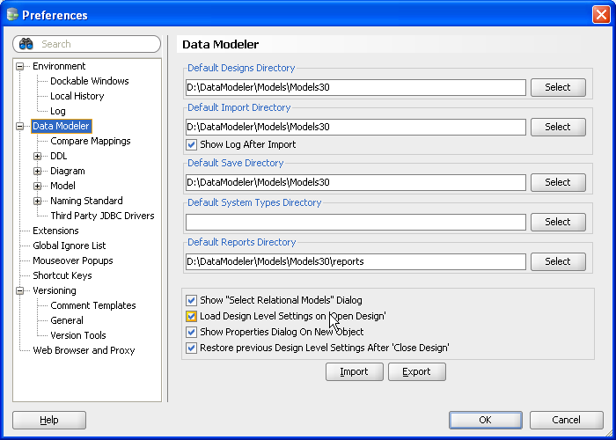
Common IDE: Fusion Client Platform
Same core technology for SQL Developer, JDeveloper and Data Modeler
Some features shared
Version control
Common look and feel
Preference dialog
Shortcut keys
Managing extensions
Set central location for saving and opening files

Slide 23
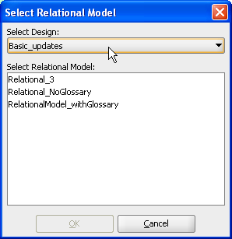
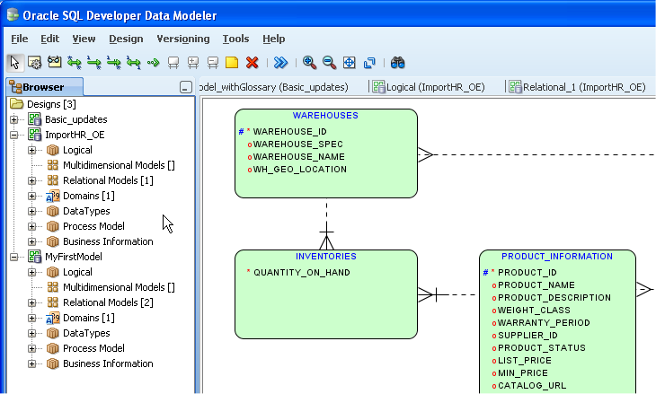
Multiple Open Designs
Open multiple designs in single Data Modeler browser
Easy to switch between designs
Use dialogs to track the current design

Slide 24
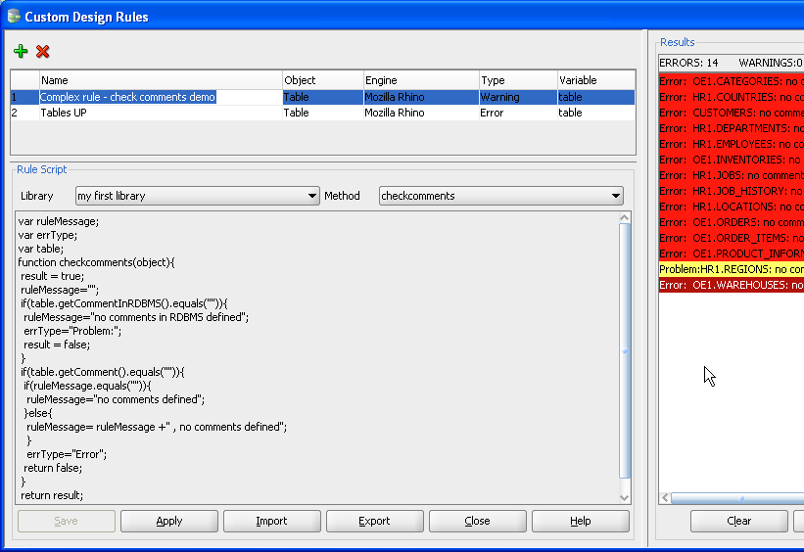
Custom Design Rules and Transformations
Use scripting engine of choice
Create user defined transformation scripts
Apply multiple scripts or rules
Build up Rule Sets
Create Libraries

Slide 25
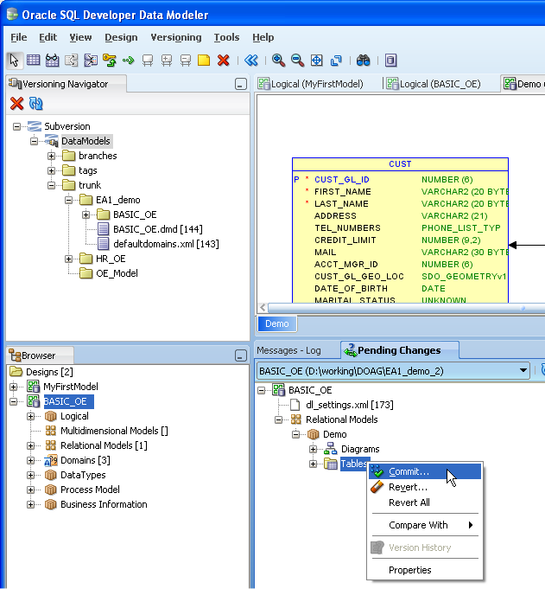
Collaborative Development
Use Versioning Navigator to connect to Subversion repository
Start by checking in Design using
Data Modeler
External client
Multiple users check out designs
Pending Changes dialog provides feedback to all users
Commit changes to repository
Manage conflicts

Slide 26
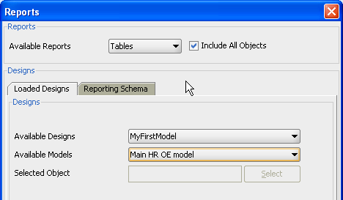
Integrated Reports
Integrated reporting supported in addition to repository reports
Generated as XML
Open in MS Word

Slide 27
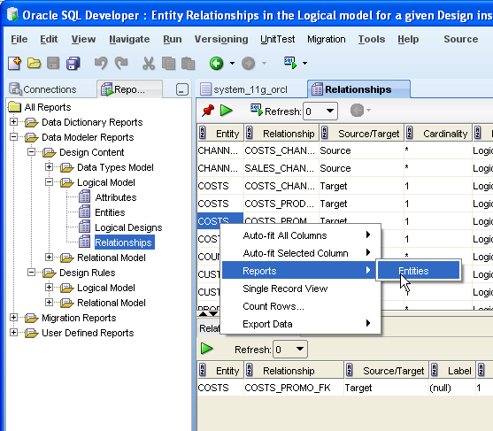
Reporting Repository
Create repository user
Export design to repository
Initial export creates repository
Exports initial version to repository
SQL Developer support
Browse repository
Import reports
Run shipped reports
Create your own reports

Slide 28
Packaging Choices
SQL Developer Data Modeler
Free, licensed with the Oracle Database, independent standalone product
SQL Developer Data Modeler extension
Integrated into Oracle SQL Developer 3.0

Slide 29
Summary
Oracle SQL Developer Data Modeler provides
Logical modeling
Relational modeling
Physical modeling
Forward and reverse engineering
Data types modeling
Multi-dimensional modeling
Data flow diagrams
Importing and exporting
Design environment control features
Integrated and repository based reporting
Integrated version control (Subversion) for collaborative development
Custom Design Rules and transformations

Slide 30
Finding More Detail www.oracle.com/technetwork/developer-tools/datamodeler/
SQL Developer Data Modeler on OTN
White papers, Oracle by Example (OBE), online demos, models and scripts
www.oracle.com/technetwork/developer-tools/datamodeler/
SQL Developer Exchange
Add feature requests: sqldeveloper.oracle.com
Forums
SQL Developer forums.oracle.com/forums/forum.jspa?forumID= 1317
Book
Oracle SQL Developer 2.1

Slide 31
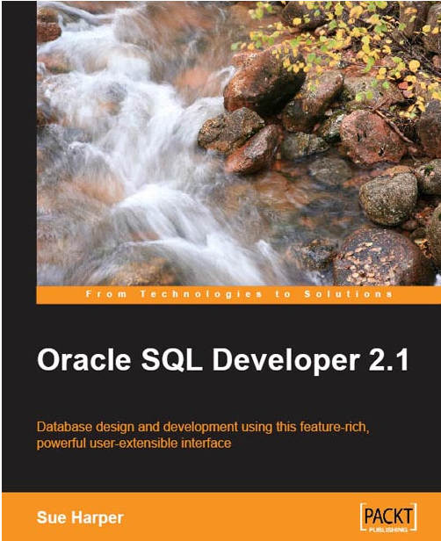
Finding More Detail

